Slide 1
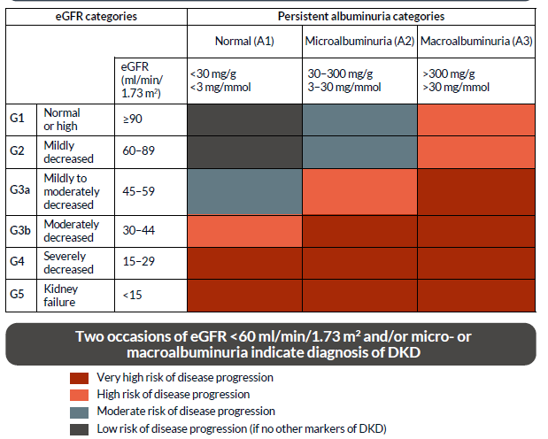
Screening for kidney disease in people with diabetes
Over time, hyperglycaemia causes damage to the kidneys, causing albumin excretion into urine (albuminuria). Early stages of kidney disease are asymptomatic so people with diabetes should have their kidney function screened at least once per year.
Screening tests include:
albumin/creatinine ratio in a spot urine sample
eGFR using serum creatinine
People with diabetes may need medication dosage adjustment if their kidney function declines.
Metformin treatment should be stopped if eGFR is <30 ml/min/1.73 m²
No dose adjustment is required for gliclazide or glipizide. Glimepiride should be started
conservatively at 1 mg daily in people with CKD stages 3, 4 and 5 (without dialysis).
No dose adjustments are required for insulin.
eGFR, estimated glomerular filtration rate; CKD, chronic kidney disease; DKD, diabetic kidney disease.
Adapted from Murton M et al. Advances in Therapy. 2021;38(1):180–200 with permission as per Creative Commons license CC BY-NC 4.0.

